Slide 1
PHY114 TUTOR SESSIONS
Monday | Tuesday | Wednesday | Thursday | Friday
Dizhou Wu | Ray Clark | Dizhou Wu | Ray Clark | Lucas Tommervik
All tutorials will be in room Olin 101,
Monday – Thursday, 5:00 pm – 7:00pm,
Friday, 4:00 pm – 6:00 pm.
The tutor sessions in past semesters past were successful and received high marks from many students.
All students are encouraged to take advantage of this opportunity.
Private tutors are also available: See Kittye McBride, department office (Olin 100)

Slide 2
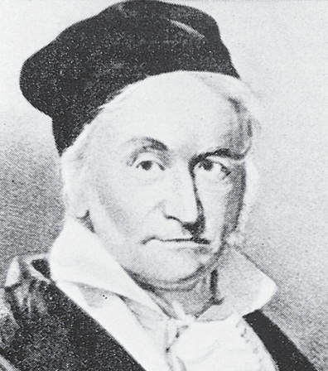
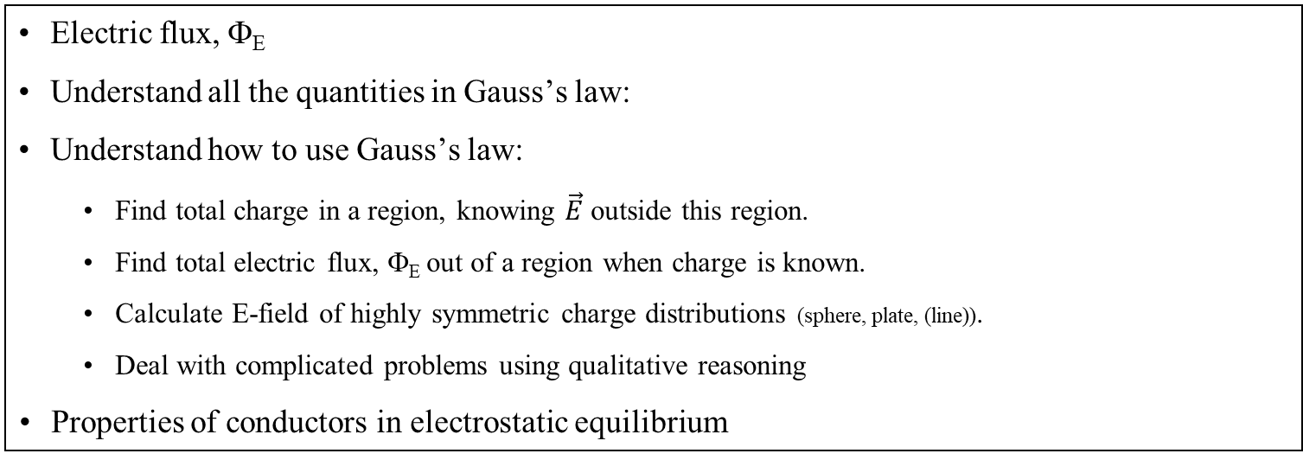
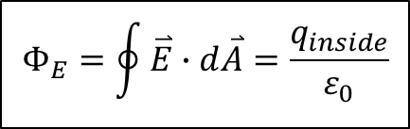
Chapter 24: Gauss’s Law
Reading assignment: Chapter 24
Homework 24.1, due Monday, Feb. 4: OQ4, OQ5, CQ2, QQ1, 3, 4, 8, 9, 10, 12, 27, 35
Homework 24.2 due Thursday, Feb. 7: OQ6, OQ9, QQ3, 57
Electric flux, Φ_{E}
Understand all the quantities in Gauss’s law:
Understand how to use Gauss’s law:
  Find total charge in a region, knowing $\vec{E}$ outside this region.
  Find total electric flux, Φ_{E} out of a region when charge is known.
  Calculate E-field of highly symmetric charge distributions (sphere, plate, (line)).
  Deal with complicated problems using qualitative reasoning
  Properties of conductors in electrostatic equilibrium
$$Φ_{E}=\oint{\overset{⃑}{E}∙d\overset{⃑}{A}}=\frac{q_{inside}}{ε_{0}}$$
  Johann C. F. Gauss,
  1777 – 1855
Coulomb constant:
Permittivity of free space:

Slide 3
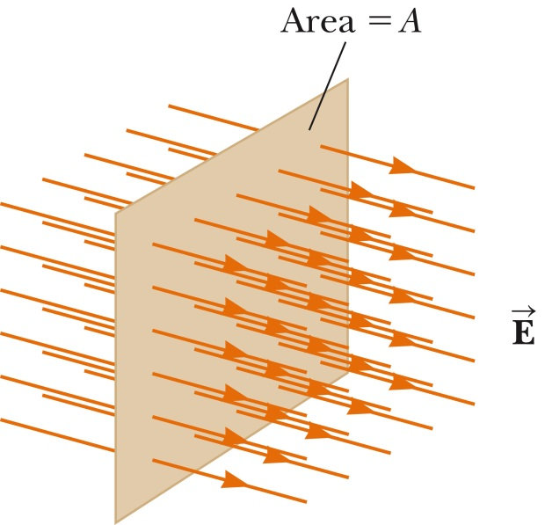
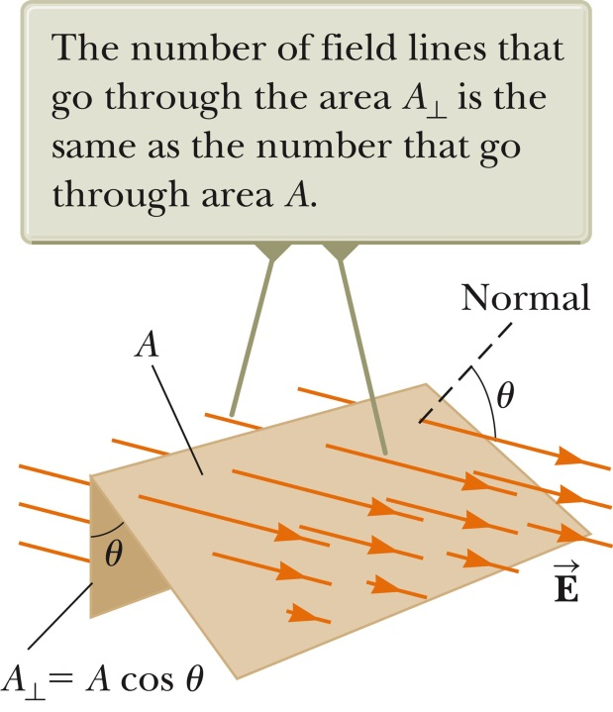



Electric flux, Φ_{E}
Electric flux, Φ_{E}, is the amount of electric field going through a perpendicular surface. When the surface is flat, and the fields are constant and uniform, the flux is:
Good analogy: Holding a bucket in shower catching water
$$φ_{E}=EA_{⊥}$$
$$φ_{E}=EAcosθ$$
$$φ_{E}=\vec{E}⋅\vec{A}$$
θ is the angle between $\hat{n}$ and $\vec{E}$; $\vec{A}=\hat{n}∙A$

Slide 4
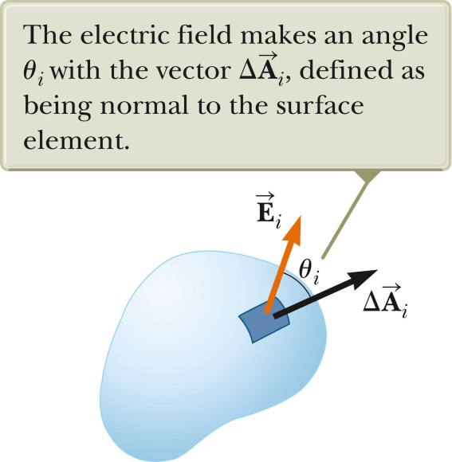

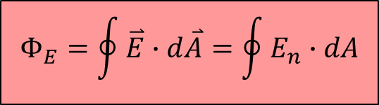
Electric flux, Φ_{E}
When the surface is curved, or the fields are not constant, we need to use the integral definition of Φ_{E}:
$$Φ_{E}=\int_{surface}{\overset{⃑}{E}∙d\overset{⃑}{A}}$$
Definition of the electric flux, Φ_{E}
The net flux through a closed surface is:
$$Φ_{E}=\oint{\overset{⃑}{E}∙d\overset{⃑}{A}}=\oint{E_{n}∙dA}$$
This is a rather abstract definition. In our applications, E is usually constant or zero over a surface, and parallel or perpendicular to a surface. Then the integral is easy to do, or becomes zero.
→ Select a (Gaussian) surface for which this is the case.

Slide 5
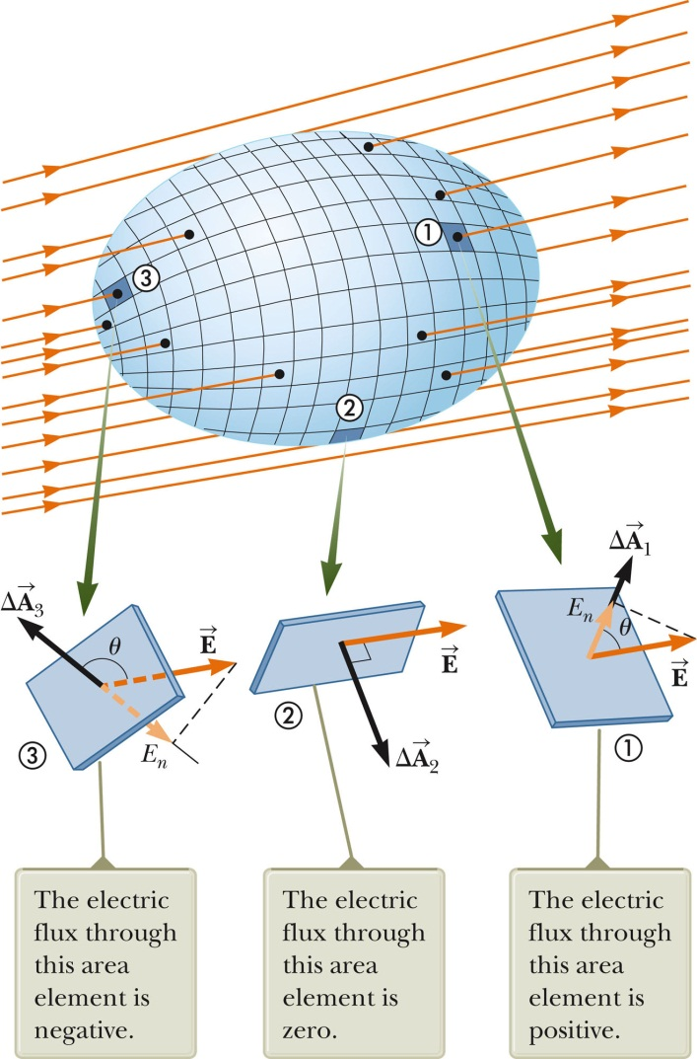
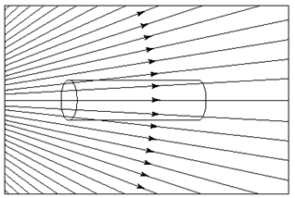
Electric flux, Φ_{E}
Sign of flux:
- E going into a closed surface: Φ_{E} is negative
- E is coming out of a surface: Φ_{E} is positive
The net flux of a closed surface is proportional to the number of lines leaving minus number of lines entering.
i-clicker 23.1
A cylindrical piece of insulating material is placed in an external electric field, as shown. The net electric flux passing through the entire closed surface of the cylinder is
Positive.
Negative
Zero.
Is the answer independent of the shape of the surface?

Slide 6
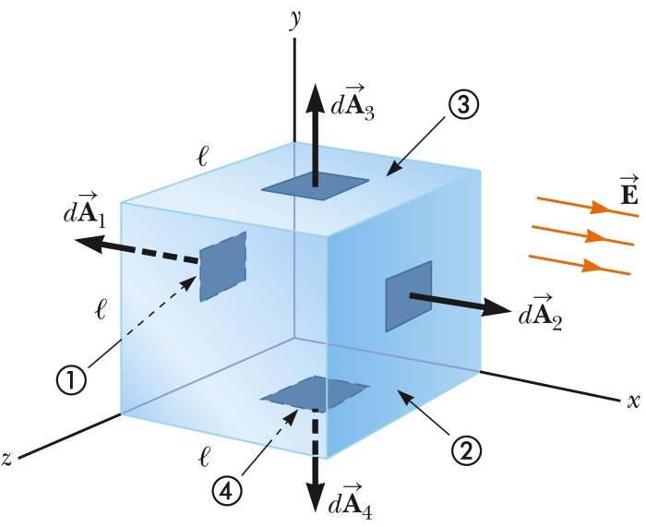
White board example 24.1
Consider a uniform electric field oriented in the x-direction in empty space. Find the net electric flux through the surface of a cube (edge length, l), placed in the field as shown in the figure.
White board example 24.2
A 40 cm diameter loop is rotated in a uniform electric field until the position of maximum electric flux (through the loop) is found.
The flux in this position is 5.20 x 10⁵ Nm²/C.
What is the electric field strength?

Slide 7
“Derivation” of Gauss’s law
i-clicker 23.2
Suppose a point charge is located at the center of a spherical surface. The electric field, E, on the surface and the total flux Φ_{E} through the surface, are determined. Now the radius of the sphere is halved. What happens to the flux, Φ_{E} , and the magnitude of the electric field, E?
Flux and field increase
Flux and field decrease
Flux increases, field decreases
Flux decreases and field increases
Flux remains the same and field increases

Slide 8
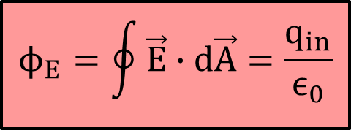
Gauss’s Law
No matter what shape you use, the total electric flux out of a region containing a point charge q is 4πk_{e}q = q/ε₀.
Why is this true?
Electric flux is just measuring how many field
lines come out of a given region
No matter how you distort the shape, the field lines
come out somewhere
If you have multiple charges inside the region their effects add
However, charges outside the region do not contribute
q
q₄
$$ϕ_{E}=\oint{\vec{E}∙d\vec{A}=\frac{q_{in}}{ϵ_{0}}}$$
q₃
q₁
q₂
Permittivity of free space:

Slide 9
Using Gauss’s Law
Gauss’s Law can be used to solve three types of problems:
Finding the total charge in a region when you know the electric field outside that region
Finding the total flux out of a region when the charge is known
  It can also be used to find the flux out of one side in symmetrical problems
  In such cases, you must first argue from symmetry that the flux is identical through each side
Finding the electrical field in highly symmetrical situations
  One must first use reason to find the direction of the electric field everywhere
  Then draw a Gaussian surface over which the electric field is constant
  Use this surface to find the electric field using Gauss’s Law
  Works generally only for spherical, cylindrical, or planar-type problems
Notes:
Warmup03 question 2; do E from point charge 1st

Slide 10
S
Q₂
i-clicker 23.3:
Which of the following statements is (are) true?
The electric field E at any point on the surface S is determined only by the charges inside S (Q₁ and Q₂).
The electric flux Φ_{E} through surface S is determined only by the charges inside S (Q₁ and Q₂).
The field E at any point on S is determined by all the charges (Q₁, Q₂ and Q₃).
The electric flux Φ_{E} through S is determined by all the charges (Q₁, Q₂ and Q₃).
Two of the above.
Q₁
Q₃

Slide 11
Using Gauss’s Law to find E-field (charged sphere)
White board example 24.3
A sphere of radius a has a total charge Q and uniform charge density ρ throughout. What is the direction and magnitude of the electric field everywhere?
All directions are created equal in this problem (radial symmetry).
The electric field will point away from the sphere at all points.
The electric field must depend only on the distance, r
Draw a sphere of radius r around this charge (Gauss surface).
Now use Gauss’s Law with this sphere
a
Like a point charge for r > a
r
Is this the electric field everywhere?
Notes:
Do point charge first
Then do as point charge with q = PV

Slide 12
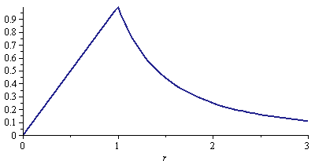

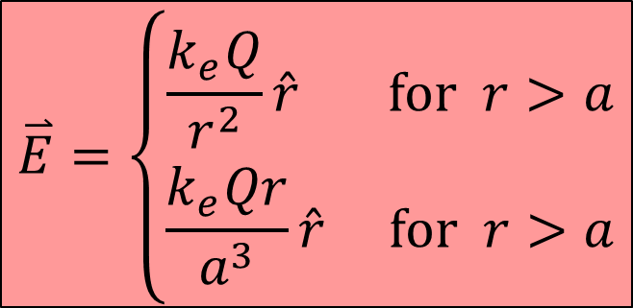
Using Gauss’s Law to find E-field (charged sphere)
White board example 24.3 (cont.)
A insulting sphere of radius a has a total charge Q and uniform charge density ρ throughout. What is the direction and magnitude of the electric field everywhere?
When computing the flux for a Gaussian surface, only include the electric charges inside the surface
$$\overset{⃑}{E}=E\hat{r}$$
$$\overset{⃑}{E}=\left\{\begin{aligned}\frac{k_{e}Q}{r^{2}}\hat{r} \text{for} r>a \\ \frac{k_{e}Qr}{a^{3}}\hat{r} \text{for} r>a\end{aligned}\right.$$
r
a
r/a

Slide 13
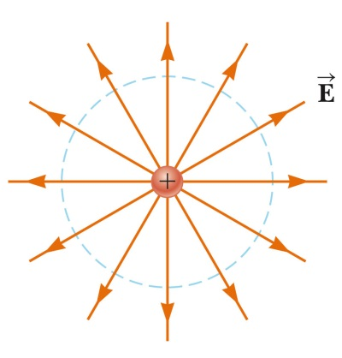


Electric Field From a Line Charge
White board example 24.4
What is the electric field from an infinite line with linear charge density λ?
$$\overset{⃑}{E}=E\hat{r}$$
L
r
Electric field must point away from the line charge, and depends only on distance
Add a cylindrical Gaussian surface with radius r and length L
Use Gauss’s Law
The ends of the cylinder don’t contribute (E is perpendicular to normal)
On the curved surface, E is parallel to the normal
$$\overset{⃑}{E}\frac{2k_{e}λ}{r}\hat{r}$$

Slide 14


Electric Field From a Plane Charge
White board example 24.5
What is the electric field from an infinite plane with surface charge density σ?
$$\overset{⃑}{E}=±E\hat{k}$$
Electric field points away from the surface, and depends only on distance d from the surface
Add a box shaped Gaussian surface of size 2d × L × W
Use Gauss’s Law
The sides don’t contribute (E-field is perpendicular to normal)
On the top and bottom, the electric field and the normal are parallel
$$\overset{⃑}{E}=±\frac{σ\hat{k}}{2ε_{0}}\hat{k}$$
Notes:
Text uses cylinder. If truly infinite, never far from it. Consider 45 degrees area pf charge increases as r squared as does 1/E.

Slide 15
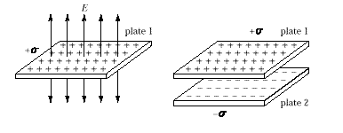
i-clicker 24.4
The electric charge per unit area is +σ for infinite plate 1 and –σ for infinite plate 2. The magnitude of the electric field associated with plate 1 is σ/(2ε₀) and the electric field lines for this plate are as shown. When the two plates are placed parallel to one another, the magnitude of the electric field is
σ/ε₀ between, 0 outside.
σ/ε₀ between, ± σ/(2ε₀) outside.
zero both between and outside.
±σ /(2ε₀) both between and outside.
none of the above.
Notes:
Text discusses this, page 699

Slide 16
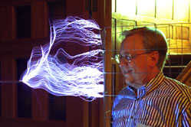
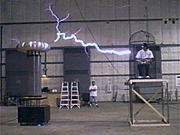
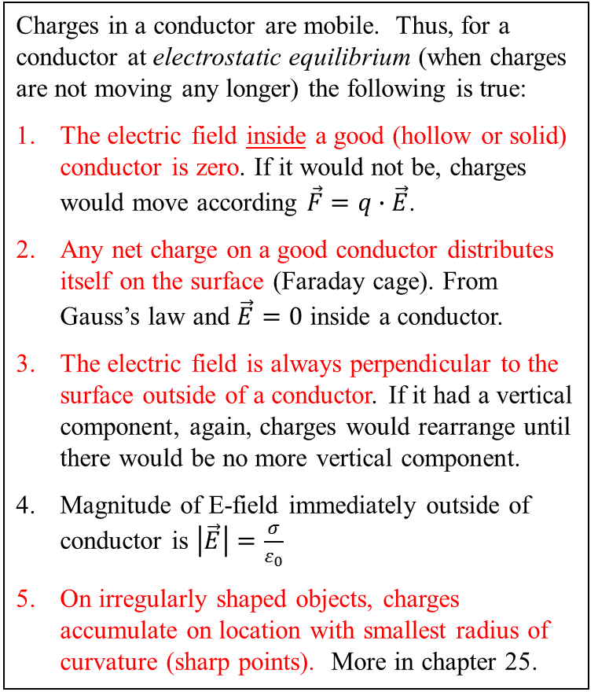
Conductors in Electrostatic Equilibrium
Charges in a conductor are mobile. Thus, for a conductor at electrostatic equilibrium (when charges are not moving any longer) the following is true:
The electric field inside a good (hollow or solid) conductor is zero. If it would not be, charges would move according $\vec{F}=q∙\vec{E}$.
Any net charge on a good conductor distributes itself on the surface (Faraday cage). From Gauss’s law and $\vec{E}=0$ inside a conductor.
The electric field is always perpendicular to the surface outside of a conductor. If it had a vertical component, again, charges would rearrange until there would be no more vertical component.
Magnitude of E-field immediately outside of conductor is $\left|\vec{E}\right|=\frac{σ}{ε_{0}}$
On irregularly shaped objects, charges accumulate on location with smallest radius of curvature (sharp points). More in chapter 25.
None of the above is necessarily true for an insulator

Slide 17
Conductors in Electrostatic Equilibrium
i-clicker 24.5
Where is the safest place during a thunderstorm (to avoid being killed by lightning)?
Inside your car
Under a tree
On an open field

Slide 18
Conductors in Electrostatic Equilibrium
i-clicker 24.6. Where does the charge go?
A hollow, conducting sphere of outer radius 2 cm and inner radius 1 cm has q = +80π nC of charge put on it. What is the surface charge density, σ, on the inner surface? On the outer surface?
20 nC/cm²
5 nC/cm²
4 nC/cm²
0
None of the above
80π nC
1 cm
2 cm
cutaway view
The electric field:
The electric field in the cavity and in the conductor is zero.
The electric field outside the conductor can be found from Gauss’s Law.
Notes:
Point charge q/4Pi eps0 w/ q = 80 pi. Note at r = 2 cm, sigma/eps0 is same: 20/4 cm^2

Slide 19
Conductors in Electrostatic Equilibrium
i-clicker 24.7
Which of the following is true?
The electric field inside a charged insulating sphere must be zero.
The electric field inside a charged, conducting sphere (metallic part) must be zero.
The charge on a conducting spherical shell will always be equally distributed on the inner and outer surface regardless of the presence of other charges in the vicinity of the shell (hint: remember induction?).
Two of the above
Three of the above

Slide 20
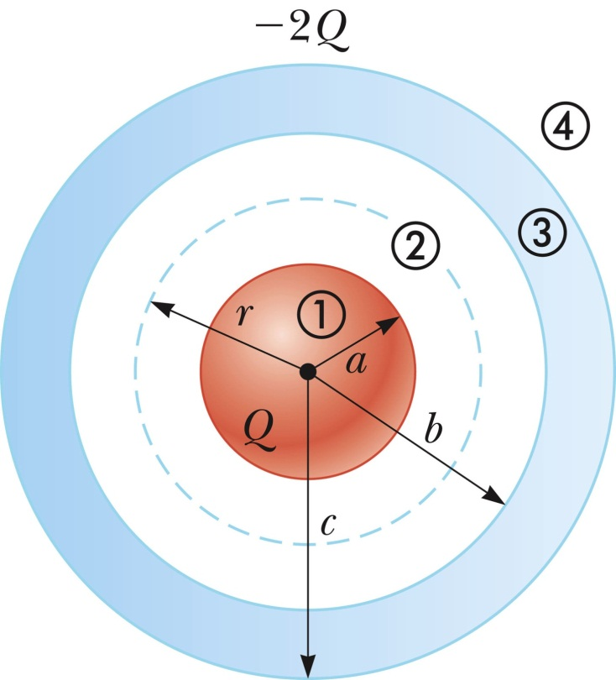
Conductors in Electrostatic equilibrium
White board example 24.7
A conducting spherical shell of inner radius, b, and outer radius, c, carries a net charge, -2Q. Concentric, inside the hollow shell is a solid insulating sphere of radius, a, carrying a net positive charge, Q, with uniform charge distribution, ρ.
Using Gauss’s law calculate the electric field everywhere.
Notes:
Charges set up to neutralize field in conductor.

Slide 21
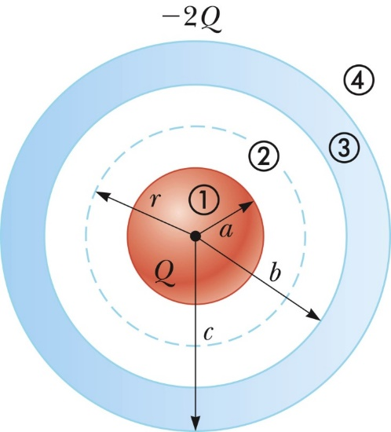
Exercise: Draw the field lines and the magnitude of the electric field for the following charge distributions
Hollow conduction shell, with charge -2Q on it
Exercise: Come up with other ‘simple geometries’

Slide 22

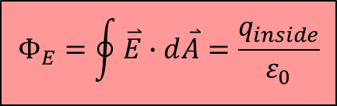

Review:
Electric flux (know what it is, how to calculate)
Gauss’s law
When using to calculate electric field we can solve the integral when:
  From geometry/symmetry find a surface over which E-field is constant
  The dot product can be simplified to E·dA, because E and A are parallel
  Or the dot product can be argued to be zero, because E and A are perpendicular
  The electric field is zero over a portion of the surface
Field of charged sphere, line, plane
Properties of conductors in electrostatic equilibrium: i) no field inside, ii) charge resides on surface, iii) field is perpendicular on conductor surface, iv) surface charge density is greatest at sharpest points).
$$Φ_{E}=\oint{\overset{⃑}{E}∙d\overset{⃑}{A}}=\frac{q_{inside}}{ε_{0}}$$
$$\overset{⃑}{E}∙d\overset{⃑}{A}$$
$$\overset{⃑}{E}∙d\overset{⃑}{A}$$

Slide 23
Extra Material

Slide 24
White board example 25.6.
Consider a long cylindrical charge distribution of Radius R with a uniform charge density ρ.
Find the electric field at distance r from the axis where r < R.
R
r
Gaussian surface
ρ
L

